Slide 1
Chapter 2: Basic Programs
Input - Calculate – Output
(calculating with numbers)

Slide 2
Motivations
Suppose, for example, that you need to take out a student loan. Given the loan amount, loan term, and annual interest rate, can you write a program to compute the monthly payment and total payment? This chapter shows you how to write programs like this.

Slide 3
Objectives
To learn how to write a program that gets numeric input from the user, calculates something, then displays the result back to the user.
To review what is a variable, focusing on numeric variables this time.
Programming Style: learn how you can and should name variables and constants.
To use numeric operators such as + - * / and ** to write numeric expressions.
To perform numeric type conversion and rounding with the int and round functions
To understand sample programs that:
  obtain the current system time by using time.time().
  compute and display the distance between two points.

Slide 4
What Most Programs Do
Most programs do this:
  Ask for input (from user or database)
  Perform calculations
  Display output (on the screen or paper)
Last week, our programs only got (character input) and displayed output.
This week, we will perform some numeric calculations.

Slide 5
Data Types in Python
Alphabetic data is also called “Character String” or just “String” data. The Python class for this type of data is called str
Numeric data:
  Integer (whole number, nothing to the right of the decimal point): Python class is called int
  Real Number (number that can have digits to the right of the decimal point): Python class is called float

Slide 6
Variables & Constants: Data Types
Reall that a variable is really just a named spot in memory where data can be stored.
In the example code, taxRate is a float (real number), total is an int (whole number), and custName is a string variable. 0.06 is a float constant, 50 is an int constant, and “Joe Hall” is a string constant.
    taxRate = 0.06
    total = 50
    total = total * (1+taxRate) # total gets larger than it was
    custName="Joe Hall"

Slide 7
Sample Program that
Calculates with Numbers
Listing 2.1 Computing the Area of a Circle
This program computes the area of the circle.
IMPORTANT NOTE:
(1) To enable the buttons, you must download the entire slide file slide.zip and unzip the files into a directory (e.g., c:\slide). (2) You must have installed Python and set python bin directory in the environment path. (3) If you are using Office 2010, check PowerPoint2010.doc located in the same folder with this ppt file.
ComputeArea
Run

Slide 8
Variables (radius and area are variables)
# Compute the first area
radius = 1.0
area = radius * radius * 3.14159
print("The area is ", area,
" for radius ", radius)
# Compute the second area
radius = 2.0
area = radius * radius * 3.14159
print("The area is ", area,
" for radius ", radius)

Slide 9
Declaring Variables?
In some languages, you must declare a variable (and say it’s data type which can then never change) before you are allowed to use it (explicit declaration), e.g., in java:
    double taxRate = 0.06;
    int total = 50;
    total = total * (1+taxRate); // total gets larger than it was
    String custName= " Joe Hall" ;
In python, you do not have to declare variables, just make up a new name and you have a new variable (implicit declaration). In python (unlike java), you can switch data types any time like this:
    age = input("How old are you?") # it’s a string here
    age = int(age) # now it’s an integer

Slide 10
Named Constants
In python there is no distinction between variables and constants (as there is in other languages like java).
Regardless, it is good programming style to use a special naming convention to indicate that a particular “variable” has a value that should not change. To indicate a “constant” name it with all uppercase letters (and _ underscore between words).

Slide 11
Example using Named Constants
# Naming convention is to use all capitals for constants
# The value of TAX_RATE should not change…
TAX_RATE = 0.06
total = total * TAX_RATE #

Slide 12
Identifiers
An identifier is any name you make up, such as a variable name or a function name (which we will learn about later).
When you make up an identifier, it can be any number of characters, but it must start with a letter or an underscore. It can include letters, digits, underscores, and/or asterisks *
An identifier cannot be a python reserved word (meaning a word that is part of the python language, such as int or str.
FOR GOOD PROGRAMMING STYLE: begin all variable names with a lower case letter. Use “Camel Case” like this:
    myFavoriteColor
  Camel Case means that you put several words together, capitalizing the first letter of each word (except the first one).

Slide 13
Trace a Program Execution
animation
Assign 20 to radius
# Assign a radius
radius = 20 # radius is now 20
# Compute area
area = radius * radius * 3.14159
# Display results
print("The area for the circle of radius " +
str(radius) + " is " + str(area))
radius
20

Slide 14
Trace a Program Execution
animation
Assign result to area
# Assign a radius
radius = 20 # radius is now 20
# Compute area
area = radius * radius * 3.14159
# Display results
print("The area for the circle of radius“,
radius, " is "area)
radius
20
area
1256.636

Slide 15
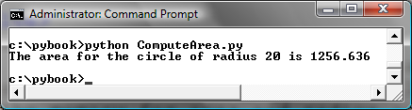
Trace a Program Execution
animation
print a message to the console
# Assign a radius
radius = 20 # radius is now 20
# Compute area
area = radius * radius * 3.14159
# Display results
print("The area for the circle of radius",
radius, "is", area)
radius
20
area
1256.636

Slide 16
Expression
x = 1 # Assign 1 to variable x
radius = 1.0 # Assign 1.0 to variable radius
# Assign the value of the expression to x
x = 5 * (3 / 2) + 3 * 2
x = y + 1 # Assign the addition of y and 1 to x
area = radius * radius * 3.14159 # Compute area

Slide 17
Assignment Statements
x = 1 # Assign 1 to x
x = x + 1
i = j = k = 1

Slide 18
Simultaneous Assignment
# example of simultaneous assignment statement
var1, var2, ..., varN = exp1, exp2, ..., expN
# means this…
var1 = exp1
var2 = exp2
#...
varN = expN
Most programming languages do not use the “simultaneous assignment” construct, so I will not use it either, but you may see it in python program examples on the web.

Slide 19
Nice Use of Simultaneous Assignment
x, y = y, x # Swap x with y
# without simultaneous assignment, you’d have to do it this way
temp = x
x = y
y = temp
ComputeAverageWithSimultaneousAssignment
Run

Slide 20
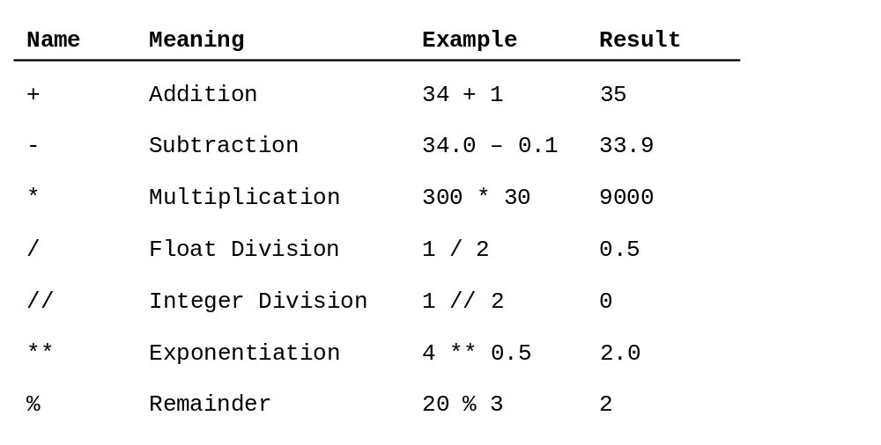
Numeric Operators

Slide 21
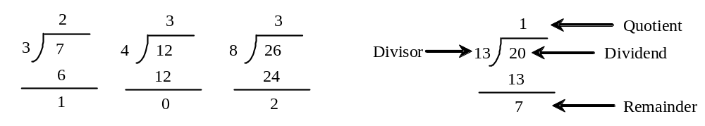
Review of Vocubulary related to Division

Slide 22

Remainder Operator
Remainder is very useful in programming. For example, an even number % 2 is always 0 and an odd number % 2 is always 1. So you can use this property to determine whether a number is even or odd. Suppose today is Saturday and you and your friends are going to meet in 10 days. What day is in 10 days? You can find that day is Tuesday using the following expression:

Slide 23
Overflow
When a variable is assigned a value that is too large (in size) to be stored, it causes overflow. For example, executing the following statement causes overflow.
>>>245.0 ** 1000
OverflowError: 'Result too large'

Slide 24
Underflow
When a floating-point number is too small (i.e., too close to zero) to be stored, it causes underflow. Python approximates it to zero. So normally you should not be concerned with underflow.

Slide 25
Scientific Notation
Floating-point literals can also be specified in scientific notation, for example, 1.23456e+2, same as 1.23456e2, is equivalent to 123.456, and 1.23456e-2 is equivalent to 0.0123456. E (or e) represents an exponent and it can be either in lowercase or uppercase.

Slide 26

Arithmetic Expressions
is translated to
(3+4*x)/5 – 10*(y-5)*(a+b+c)/x + 9*(4/x + (9+x)/y)

Slide 27
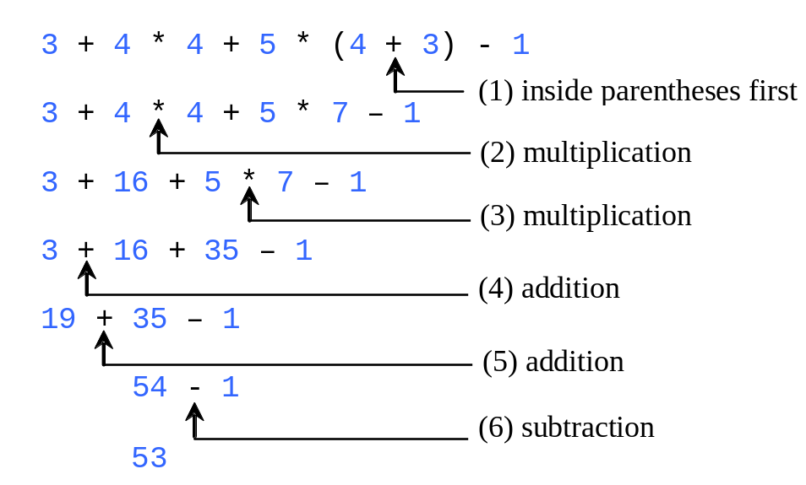
Order of Evaluation in a Numeric Expression
Though Python has its own way to evaluate an expression behind the scene, the result of a Python expression and its corresponding arithmetic expression are the same. Therefore, you can safely apply the arithmetic rule for evaluating a Python expression.
Please-parentheses
Excuse-exponents
My-multiplication
Dear-division
Aunt-addition
Sally-subtraction

Slide 28
Order of Evaluation
(of arithmetic expressions)
I do not expect you to memorize the order of evaluation of arithmetic expressions. Just be aware that it is not just left to right and that you should use parentheses to be sure that the order of evaluation is what you want it to be.
Please-parentheses
Excuse-exponents
My-multiplication
Dear-division
Aunt-addition
Sally-subtraction

Slide 29
Augmented Assignment Operators
Operator Example Equivalent
+= i += 8 i = i + 8
-= f -= 8.0 f = f - 8.0
*= i *= 8 i = i * 8
/= i /= 8 i = i / 8
%= i %= 8 i = i % 8
Since this notation is found in a lot of languages (e.g., java, C++), it is good to learn it.

Slide 30
Type Conversion and Rounding
datatype(value)
i.e., int(4.5) evaluates to 4
float(4) evaluates to 4.0
str(4) evaluates to “4”
round(4.6) evaluates to 5
round(4.5) evaluates to 4

Slide 31
Problem: Keeping Two Digits After Decimal Points
Write a program that displays the sales tax with two digits after the decimal point.
SalesTax
Run

Slide 32
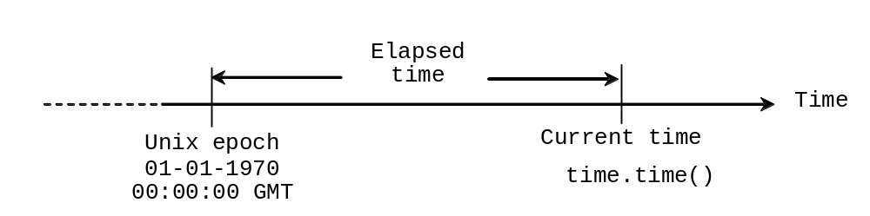
Problem: Displaying Current Time
Write a program that displays current time in GMT in the format hour:minute:second such as 1:45:19.
The time.time() function returns the current time in seconds with millisecond precision since the midnight, January 1, 1970 GMT. (1970 was the year when the Unix operating system was formally introduced.) You can use this function to obtain the current time, and then compute the current second, minute, and hour as follows.
ShowCurrentTime
Run

Slide 33
Reading Input from the Console
1. The input function returns a string
  strSalary = input("Enter your salary: ")
2. If you want to do arithmetic with the input, you must first convert the character string data to number type. Float means a real number. Int means an integer or whole number.
  floatSalary = float(strSalary) # real number
  intSalary = int(Salary) # integer (whole number)
ComputeAreaWithConsoleInput
Run

Slide 34
Reading Input from the Console
But since python allows you to change the data type of a variable "on the fly", you might find this easier (less variables to keep track of):
  salary = input("Enter your salary: ")
  salary = float(salary) # convert to real number
ComputeAverage
Run

Slide 35
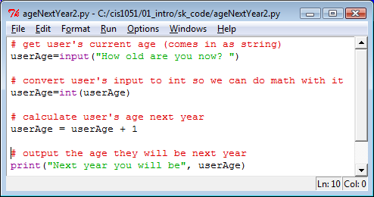

Program: input, compute, output

Slide 36
Reading Input from the Console
Here is another way to convert String input into a numeric type (float or int). In the code below, whatever type the user enters will be used. For example, if the user enters a whole number (like 6), intRate will be an int, but if the user enters a real number (like 3.25), intRate will be a float.
intRate = eval(input( "Enter interest rate, e.g., 8.25: "))
Although this is an over-simplification, for now, you can think of the eval function as just removing the quotes (that you might imagine as) surrounding the user's input.

Slide 37

Problem:
Computing Loan Payments
This program lets the user enter the interest rate, number of years, and loan amount, and computes monthly payment and total payment.
ComputeLoan
Run

Slide 38
Try It Yourself
Write a program that does this:
Ask the user the price of something they purchased.
Ask how many of that item they bought.
Calculate the total price paid (price times number of items bought).
Remember you have to convert string input to numbers before you can do any math.
Don’t forget to use comments.

Slide 39
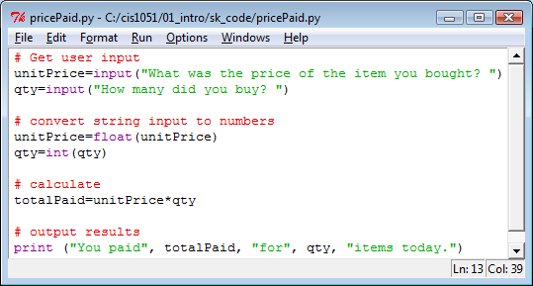

Answer: PricePaid.py

Slide 40
Programming Style and Documentation
Remember how you should name variables ("camel case") and constants (all caps, using underscores). All identifiers should be meaningful so that your program is "self documenting".
Appropriate Comments (see next slide)
Proper Indentation and white space

Slide 41
Appropriate Comments
At the beginning of every program, include comments that show:
the name of your program and a brief summary of what it does.
your name, your class/section, and date.
Add comments thoughout your program, to explain what you are doing.
You might ask, "how much is too much?" or "how much is too little?" when it comes to commenting. At this early stage in the game, try to put a comment in front of each group of several lines of code. It will make your code easier to read and even help you understand it better.

Slide 42
Proper Indentation and Spacing
Indentation
  Indent four spaces.
  A consistent spacing style makes programs clear and easy to read, debug, and maintain.
Spacing
  Use blank line to separate segments of the code.

Slide 43

Case Study: Computing Distances
This program prompts the user to enter two points, computes their distance, and displays the points.
ComputeDistance

Slide 44
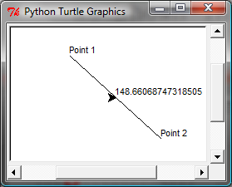
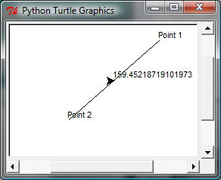
Case Study: Computing Distances
This program prompts the user to enter two points, computes their distance, and displays the points and their distances in graphics.
ComputeDistanceGraphics

